Slide 1

DEPARTMENT OF ARTIFICIAL INTELLIGENCE AND DATA SCIENCE
Artificial Neural Networks and Deep Learning: 21ADG64
LA1 - Seminar
“Variational Auto-Encoders”
Presented By
Name : Shiv Shankar Singh
USN : 1NT21AD045
Name of the Course Instructor Dr Meenakshi

Slide 2

CONTENTS
Introduction and Motivation
Methodology and Approach
Results and Analysis
Conclusion and Future Recommendations
Demo video of code
Git hub link of PPT and Code
References

Slide 3
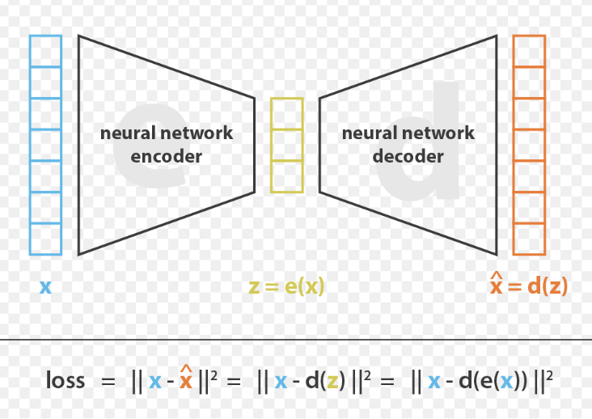
INTRODUCTION & MOTIVATION
Variational autoencoders (VAEs) are neural network architectures that excel in unsupervised learning, capturing complex data patterns without explicit labels. Unlike traditional autoencoders, VAEs can not only encode data but also generate new samples from learned representations. They blend deep learning with probabilistic modeling, optimizing the likelihood of observed data while regularizing the latent space. This dual objective fosters versatile applications in image generation, anomaly detection, and data compression. VAEs bridge the gap between neural networks and probabilistic models, offering a powerful framework for understanding and representing data distributions.
In summary, variational autoencoders offer a compelling approach to unsupervised learning by combining the expressive power of neural networks with probabilistic modeling techniques, paving the way for advancements in artificial intelligence and machine learning research.

Slide 4
Methodology & Approach
Building variational autoencoders (VAEs) involves a multi-step methodology combining neural network architecture design and probabilistic modeling techniques.
Architecture Design: VAEs typically consist of two main components: an encoder and a decoder. The encoder maps input data into a latent space representation, while the decoder reconstructs the data from this representation. Both encoder and decoder are often implemented using neural networks, with architectures tailored to the specific characteristics of the data domain.
Variational Inference: VAEs leverage variational inference to train the model effectively. This involves formulating the problem as an optimization task to maximize the evidence lower bound (ELBO), which balances reconstruction fidelity and latent space regularization. The ELBO is optimized using gradient-based methods such as stochastic gradient descent.
Sampling from Latent Space: During training, VAEs sample latent vectors from a learned distribution to generate data samples. This enables the model to learn a meaningful latent space representation that captures the underlying data structure.

Slide 5
Loss Function: The loss function for VAEs typically comprises two terms: a reconstruction loss, measuring the fidelity of the reconstructed data, and a regularization term, enforcing similarity between the learned latent distribution and a prior distribution (often Gaussian).
Training Procedure: VAEs are trained on large datasets using mini-batch gradient descent. The training process involves iteratively updating the model parameters to minimize the loss function, with careful consideration given to hyperparameters such as learning rate, batch size, and network architecture complexity.
Evaluation: Evaluation of VAEs involves assessing the quality of generated samples, the fidelity of reconstructed data, and the effectiveness of the learned latent space representation. Common metrics include reconstruction error, likelihood estimation, and visual inspection of generated samples.
By following this methodology, researchers and practitioners can develop variational autoencoders capable of learning rich and meaningful representations of complex data distributions, enabling a wide range of applications in artificial intelligence and machine learning.

Slide 6
Results & Analysis
The results and analysis of variational autoencoders (VAEs) typically focus on several key aspects:
Reconstruction Quality: Evaluating how well VAEs reconstruct input data is crucial. This involves measuring the reconstruction error or comparing the original input data with the reconstructed output. Lower reconstruction error indicates better reconstruction quality.
Sample Generation: VAEs can generate new data samples by sampling from the learned latent space. Assessing the quality of generated samples involves visual inspection and comparing them with real data samples. High-quality samples closely resemble the characteristics of the training data.
Latent Space Analysis: Analyzing the learned latent space is essential for understanding the representations captured by VAEs. Techniques such as dimensionality reduction and visualization can reveal clusters and patterns in the latent space, providing insights into the underlying data structure.
Interpolation and Manipulation: VAEs enable smooth interpolation between data points in the latent space. By interpolating between latent representations of different data samples, it's possible to generate new, meaningful transitions in the data space. Additionally, manipulating specific dimensions of the latent space can result in controlled changes in the generated samples.

Slide 7
Diversity and Novelty: Assessing the diversity and novelty of generated samples is crucial for evaluating the generative capabilities of VAEs. High diversity indicates that the model can capture various modes of the data distribution, while novelty measures the ability to generate new, unseen samples.
Evaluation Metrics: Various metrics, such as Frechet Inception Distance (FID) or Inception Score (IS) for image data, can provide quantitative measures of the quality and diversity of generated samples. Likelihood-based metrics can also be used to evaluate the model's ability to accurately estimate the data distribution.
Overall, the analysis of VAEs involves a comprehensive examination of reconstruction quality, sample generation, latent space structure, diversity, and novelty. By carefully evaluating these aspects, researchers can gain insights into the strengths and limitations of VAEs and further advance the field of generative modeling and unsupervised learning.

Slide 8
Conclusion & Future Recommendations
Looking ahead, there are several promising directions for advancing variational autoencoders (VAEs) and enhancing their capabilities:
Improving Latent Space Representations: Research can focus on developing techniques to learn more informative and disentangled representations in the latent space. This could involve exploring novel regularization methods, architectural modifications, or incorporating additional constraints to encourage meaningful latent features.
Scalability and Efficiency: Scaling VAEs to handle large-scale datasets efficiently remains a challenge. Future research could explore techniques for training VAEs on distributed systems, designing more efficient architectures, or developing novel optimization algorithms to improve scalability without compromising performance.
Robustness and Interpretability: Addressing issues related to model robustness and interpretability is essential for deploying VAEs in real-world applications. Future research can explore techniques for robust training, uncertainty estimation, and model interpretability to enhance the trustworthiness and transparency of VAEs.
By addressing these challenges and exploring new research directions, VAEs can continue to evolve as powerful tools for unsupervised learning, generative modeling, and various applications in artificial intelligence and machine learning.

Slide 9
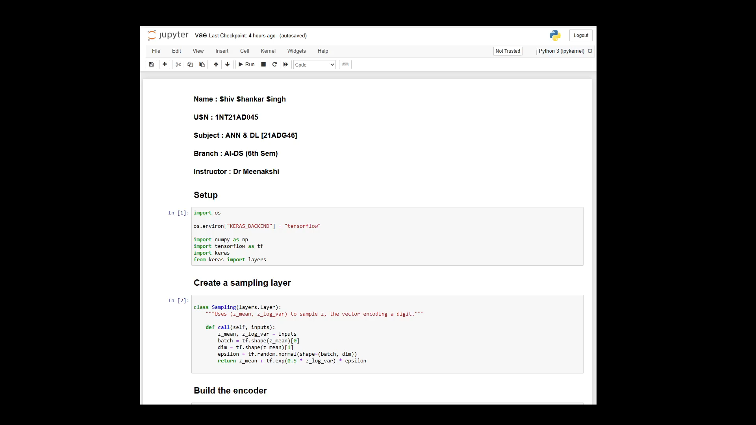

Slide 10
References :
Github Link : https://github.com/shivshankarsingh19/VariationalAutoEncoders
https://www.youtube.com/watch?v=9zKuYvjFFS8
https://www.youtube.com/watch?v=fcvYpzHmhvA
https://www.mathworks.com/help/deeplearning/ug/train-a-variational-autoencoder-vae-to-generate-images.html

Slide 11

NAME : SHIV SHANKAR SINGH
USN : 1NT21AD045

